Slide 1
New Jersey Offshore Wind Transmission State Agreement Approach
Ratepayer Protections and Cost Controls
In the Matter of Declaring Transmission To Support Offshore Wind a Public Policy of the State of New Jersey
Docket number QO20100630

Slide 2
Ratepayer Protections and Cost Controls
Explore how the cost of potential SAA projects will be borne and allocated

Slide 3
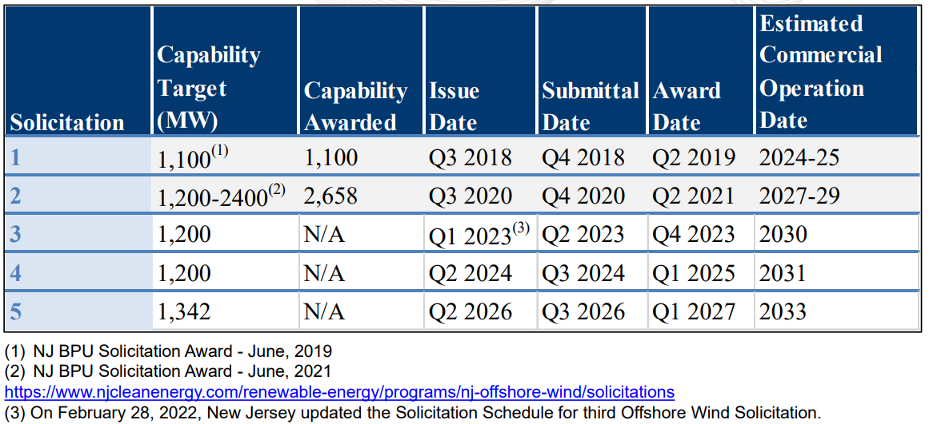
NJ Offshore Wind Generation Solicitation Schedule

Slide 4
NJ Offshore Wind Transmission
PJM Interconnection is New Jersey’s regional grid operator
BPU identified the potential benefits of soliciting coordinated market-based options for building out the transmission facilities necessary to achieve this goal
In its November 2020 order, BPU requested PJM to solicit competitive transmission proposals for New Jersey via the State Agreement Approach (SAA)

Slide 5
PJM State Agreement Approach
In compliance with FERC Order No. 1000, PJM developed the SAA to provide for the consideration of transmission needs driven by Public Policy Requirements in the regional transmission planning processes, known at its Regional Transmission Expansion Plan (RTEP)
The SAA allows state governmental entities authorized by their respective states to be responsible, voluntarily, for the allocation of costs of a proposed transmission expansion or enhancement that addresses state public policy requirements that the applicable state(s) in the PJM Region have identified or accepted

Slide 6
2021 SAA to Support NJ Offshore Wind
PJM with BPU Staff developed a solicitation for electric transmission project applications under the SAA to meet New Jersey’s public policy
  Window Opened: April 15, 2021
  Window Closed: September 17, 2021
The solicitation requested Applications for four distinct options shown on the next slide, with each entity having the choice to propose more than one option
PJM received Applications from 13 entities proposing a total of 80 projects

Slide 7
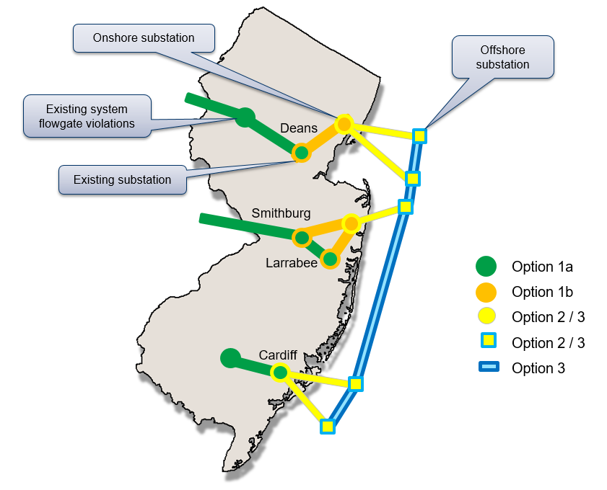

Slide 8
SAA Evaluation Process
BPU Staff is currently working with PJM to evaluate the SAA proposals
PJM and BPU Staff are also evaluating project costs, constructability, risk mitigation, environmental impacts, permitting plan, quality of proposal and developer experience, flexibility, modularity, and option value, and additional New Jersey benefits

Slide 9
SAA Cost to Ratepayers
11/18/20 Board Order:
“The Board takes this action to confirm the State's commitment to the development of offshore wind generation, in a manner that may lead to more efficient and cost-effective incorporation of offshore wind generation into New Jersey’s transmission grid…”
“Staff and its consultant believe that such a coordinated and planned approach could:
- Result in more efficient or cost effective transmission solutions versus a non-coordinated transmission planning process…”

Slide 10
SAA Cost Containment
Governed by PJM’s Regional Transmission Expansion Plan (RTEP) rules
11/18/2020 Board Order:
“the Board notes that it will weigh heavily proposals from transmission developers that utilize the voluntary protections laid out in the SAA process to limit down-side risk to New Jersey consumers…”
Solicitation guidance
Proposals contain specific cost containment measures

Slide 11
Building A Better Grid Overview

Slide 12
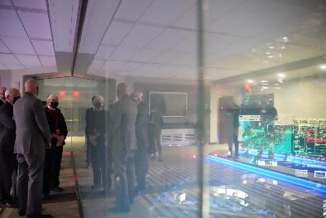

Building a Better Grid Initiative
DOE’s Building a Better Grid Initiative launched in January 2022
In an NOI, DOE outlined the need for national transmission investment and the tools DOE has to drive that investment (coordination, planning, financing, permitting, and RD&D)
The NOI focused heavily on new financing tools from BIL

Slide 13
Building a Better Grid Initiative
Building a Better Grid will support the development of nationally significant transmission projects and grid upgrades by:
  Engaging and collaborating early with states, tribal nations, and stakeholders to accelerate transmission deployment.
  Enhancing transmission planning to identify areas of greatest need such as high-priority national transmission needs and conducting longer-term national-scale transmission planning analysis.
  Deploying more than $20 billion in federal financing tools, including through the Bipartisan Infrastructure Law’s new $2.5 billion Transmission Facilitation Program, $3 billion expansion of the Smart Grid Investment Grant Program, and more than $10 billion in grants for states, Tribes, and utilities to enhance grid resilience and prevent power outages, and through existing tools, including the more than $3 billion Western Area Power Administration Transmission Infrastructure Program, and a number of loan guarantee programs through the Loan Programs Office.
  Facilitating an efficient transmission permitting process by coordinating with federal agencies to streamline permitting, using public private partnerships, and designating corridors.
  Performing transmission-related research and development to continue developing and reducing the costs of technologies that enable the transmission system to be used more efficiently.

Slide 14
IIJA Provisions: Funded Transmission Provisions
Funding | Program
$5.0B | Preventing Outages and Enhancing the Resilience of the Electric Grid / Hazard Hardening – sec. 40101
$5.0B | Program Upgrading Our Electric Grid and Ensuring Reliability and Resiliency – sec. 40103(b)
$2.5B | Transmission Facilitation Program / Borrowing Authority – sec. 40106
$3.0B | Smart Grid Investment Matching Grant Program – sec. 40107

Slide 15
Transmission Facilitation Program (TFP) – Overview
BIL § 40106
$2.5B revolving fund to facilitate development of eligible projects:
  New or replacement high-capacity transmission lines
  Increasing capacity of existing lines
  Connecting isolated microgrids in AK, HI, and U.S. territories
Three tools:
Anchor customer. DOE can purchase capacity, to be resold once a project’s financial viability has been demonstrated
  Up to 50% of a project’s planned capacity
  Terms of up to 40 years
Loans. DOE can make loans to carry out eligible projects
Public Private Partnership. DOE can participate in designing, developing, constructing, operating, maintaining, or owning an eligible project:
  In a Transmission Corridor or necessary to accommodate electricity capacity demand increase across multiple States or transmission planning regions, among other criteria
  Can overcome state siting/permitting obstacles
  Can use contributed funds from project developers

Slide 16
IIJA Provisions: Funded Resilience Provisions
Funding | Program
$5.0B | Preventing Outages and Enhancing the Resilience of the Electric Grid / Hazard Hardening – sec. 40101
$5.0B | Program Upgrading Our Electric Grid and Ensuring Reliability and Resiliency – sec. 40103(b)
$2.5B | Transmission Facilitation Program / Borrowing Authority – sec. 40106
$3.0B | Deployment of Technologies to Enhance Grid Flexibility– sec. 40107

Slide 17
Preventing Outages and Enhancing the Resilience of the Electric Grid (Grid Hardening Grants)
BIL § 40101
$5 Billion ($1 Billion per year) for FY 2022–2026
  Half to states via a formula grant
    15% cost share; can be passed thru to industry (must match grant)
  Half to industry via a competitive solicitation
    Small utility set aside of 30%
    Industry must match grants; Capped at the amount the eligible entity has spent in the previous 3 years on hardening efforts
  Guidance/Allowance regarding technical assistance
Grants for supplemental hardening activities to reduce risks of power lines causing wildfires and the likelihood and consequence of impacts to the electric grid due to extreme weather, wildfires, and natural disasters.
No new generation or cybersecurity activities authorized.

Slide 18
Program Upgrading Our Electric Grid and Ensuring Reliability and Resiliency (Grid Resilience Demos)
BIL § 40103(b)
$5 Billion ($1 Billion per year) for FY 2022–2026
to demonstrate innovative approaches to transmission, storage, and distribution infrastructure to harden and enhance resilience and reliability; and
to demonstrate new approaches to enhance regional grid resilience, implemented through States by public and rural electric cooperative entities on a cost-shared basis.
Eligible entities:
a State;
a combination of 2 or more States;
an Indian Tribe;
a unit of local government;
a public utility commission

Slide 19
Deployment of Technologies to Enhance Grid Flexibility
(Smart Grid Grants)
BIL § 40107
Provides $3.0B ($600M per year) for FY 2022–2026 for Smart Grid Investment Matching Grants (SGIG)
  Competitive Solicitation
  Industry must match investments
Section 40107 amends the SGIG program to additionally support:
  Data analytics enabling software smart grid functions
  Building devices and software supporting demand flexibility and smart grid functions
  Operational fiber and wireless broadband communications networks enabling data flow between distribution system components
  Advanced transmission technologies, including dynamic line rating, flow control devices, advanced conductors, and network topology optimization, to increase the operational transfer capacity transmission networks

Slide 20

CONSIDERATIONS ON COST CONTAINMENT
Larry Gasteiger, Executive Director, WIRES

Slide 21



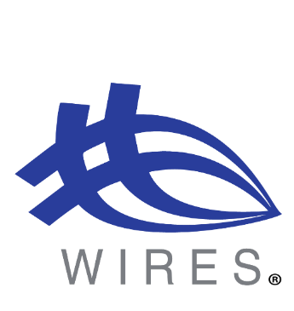
Balancing cost with focus on safety, reliability and ‎customer service
Is “lowest cost” the only goal?‎
  Determining/defining what lowest cost means
  Factoring a lowest cost approach into upfront project ‎design, execution, construction, and O&M over the ‎long-term life of the project – already seeing the consequences

Slide 22



Capping costs – What does a “cost cap” really mean and what are customers really getting?
Hard cost caps
  Real or illusory?‎
  Exclusions from cost caps
    Can be significant and render the cost cap effectively meaningless
    Who is “minding the store” on cost cap exclusions? What is the monitoring mechanism?

Slide 23

What does “lowest cost” mean for quality?
Does New Jersey want a Yugo?

Slide 24
Other Cost Containment Considerations
Opportunities to use existing easements
RFP processes
Robust public engagement throughout life cycle of project

Slide 25
The Case For a Tailored Approach to Offshore Wind Interconnections
NJ BPU Stakeholder Meeting #4
April 12, 2022
1

Slide 26



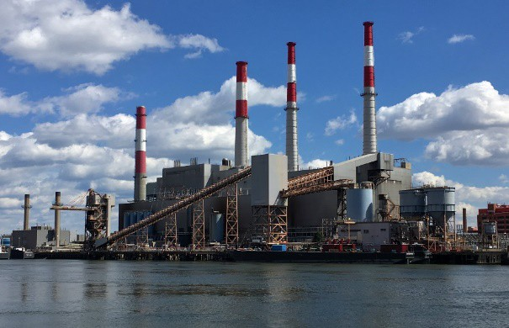
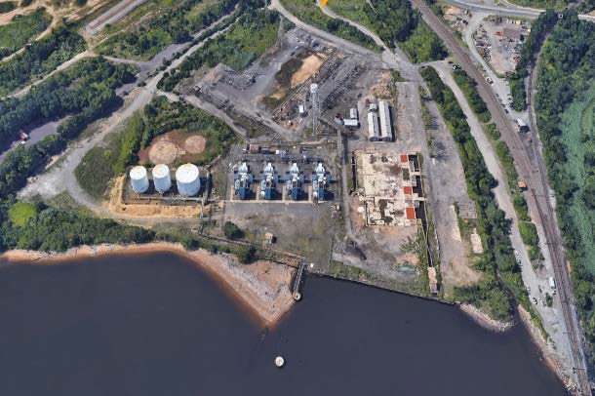

Leading the Energy Transition in the NJ / NY Metro Area
Focused on repurposing legacy fossil generating sites into hubs for clean energy
Owns 2 principal assets: Ravenswood & Werner
Wholly-owned subsidiary of LS Power, national leader in Power Generation and Transmission
Ravenswood Generating Station
Queens, New York
Werner Power Station
South Amboy, New Jersey
Operated by Rise, employing over 100 union men and women
Largest single generating facility in New York City at 2,050 MW
Located on 28 waterfront acres
Former coal powered facility acquired by Rise in 2021
Located on 50 acres (26 acres of dry land + 24 acres submerged lands owned in fee)
Brownfield site; remediation largely complete
2

Slide 27
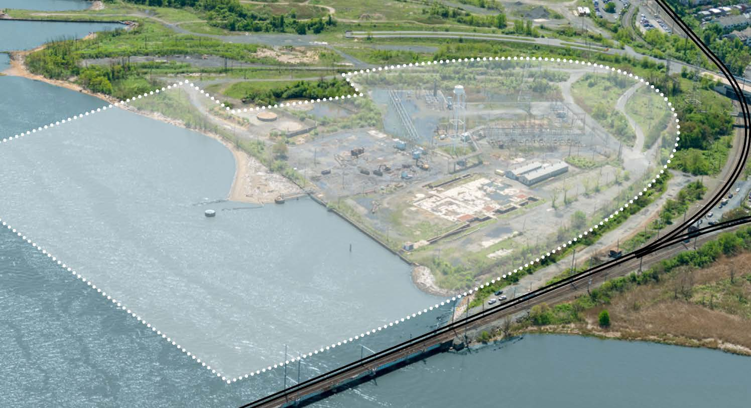
Our Vision is to Transform a South Amboy Brownfield…
Aerial of Werner Site (Current State)
3

Slide 28
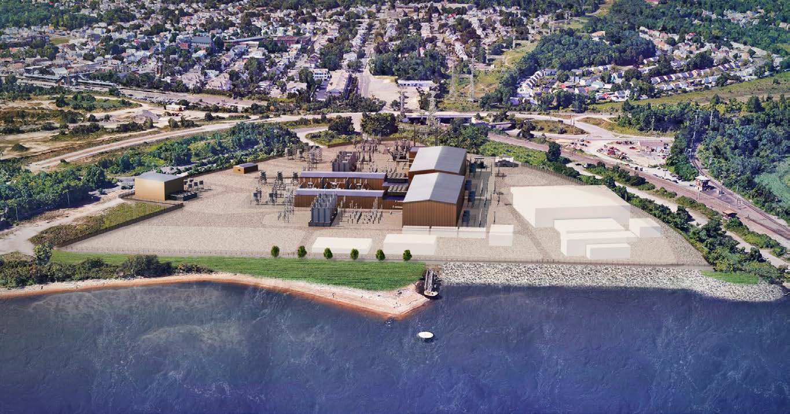
… into a Renewable Energy Hub for Offshore Wind
Concept rendering. Subject to change based on project configuration.
Werner Generating Station is an ideal location to land cables from offshore wind farms:
  On the waterfront, with no nearby recreational beaches
  Industrially zoned brownfield site that hosted a fossil fuel plant from 1929 to 2015
  Existing substation on location with high voltage transmission already connecting it to the rest of the New Jersey electric network
To be constructed and maintained by New Jersey-based union labor
Ultimate specifications will be tailored to fit with character of the South Amboy community
4

Slide 29
Including Option 1B Solutions to Interconnect Offshore Wind Projects Will Be More Beneficial to Ratepayers
HVAC Allows Offshore Wind Developers to Maximize Offshore Wind Capacity, Leading to Lower Costs
Final Lease Areas Makes HVAC More Attractive for >70% of Uncommitted Offshore Wind Capacity
Giving Greater Project Control to Offshore Wind Developers Lowers Risks to Ratepayers
HVAC: High Voltage Alternating Current
5

Slide 30
HVAC Allows Offshore Wind Developers to Maximize Offshore Wind Capacity, Leading to Lower Costs
Feature | Advantage | How it Lowers Costs to Ratepayers
Modular | HVAC cables provide capacity in 300 to 400 MW increments – allowing OSW developers to better align the maximum capacity of their lease areas with the potential injection (and OREC offer) into NJ In contrast, HVDC cables provide capacity in 1,200 MW increments | Spreads cost of lease over greater number of energy production → resulting in a lower cost per megawatt-hour (which lowers OREC cost)
Proven Technology for OSW Industry | Well established global supply chain for HVAC Well known to banks that finance OSW projects | Reduces project-on-project risk due to delays in equipment delivery and/or installation
Lower Cost to Build | Onshore converter stations cost significantly less Avoids placing converter stations off-shore | Lower capital cost per megawatt-hour (which lowers OREC cost) Reduces project-on-project risk due to delays in delivery due to limited number of vessels capable of installing offshore converter stations
Lower Cost to Operate & Maintain | Converter station is onshore → more accessible when needed, reducing downtime | Lower operating cost per megawatt-hour (which lowers OREC cost) as infrastructure is onshore
Higher Reliability | OSW farms not reliant on a single offshore transmission cable | Failure on a single HVAC cable does not jeopardize energy production of an entire OSW farm
HVDC: High Voltage Direct Current
OREC: Offshore Renewable Energy Credits
6

Slide 31
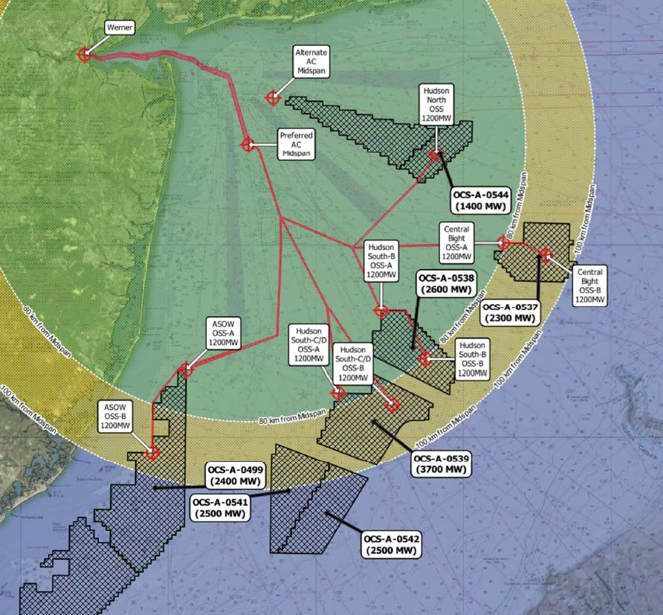
Final Lease Areas Makes HVAC More Attractive for
>70% of Uncommitted Offshore Wind Capacity
Offshore Wind Lease Areas that Can Connect to Outerbridge via HVAC
Varying Locations. Some are in Southern NJ; others farther north
Non-Uniform Size. Wide range of energy generation capacity across the lease areas
Unique Shapes. Affects how offshore wind developers will position the equipment to maximize energy production while minimizing cost
Imperfect Capacity Alignment. Energy generation capacity on each lease area does not neatly align with PJM N-1 single unit contingency of 1,500 MW, or the economically efficient capacities of an HVDC system
HVDC: High Voltage Direct Current
7

Slide 32
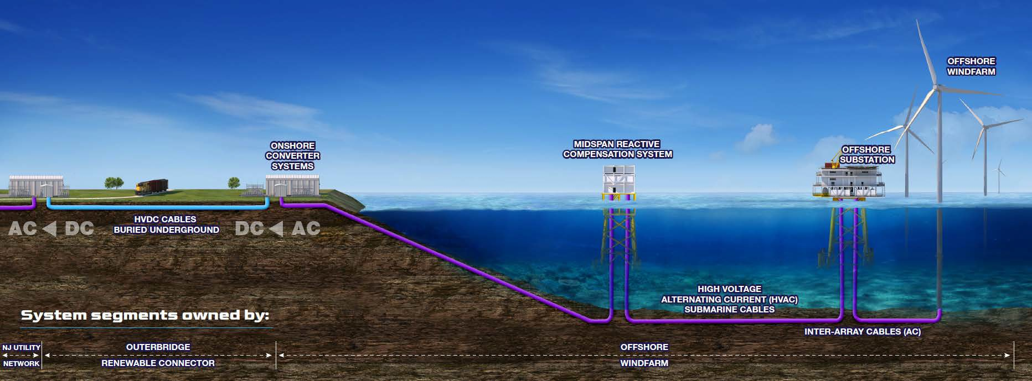
Giving Greater Project Control to Offshore Wind Developers Lowers Risks to Ratepayers
Outerbridge Option 1B Proposal
Feature of Option 1B Proposal | Why it Lowers Risks to Ratepayers
1. Entire offshore solution is owned by OSW developer | Ability to design system that maximizes energy production & minimizes cost Eliminates offshore integration and coordination risk
2. Shifts cost of offshore solution to OSW developer, who will have to recover costs via ORECs | Energy production must be maximized to lower OREC costs → spreads high cost of lease to the most number of megawatt-hours OSW developer accountable for building a reliable solution as ORECs cannot be recovered if electricity is not delivered onshore
3. Since entirely onshore, project can be constructed ahead of OSW farms | Lowers project on project risk, ensuring onshore transmission is in place for OSW farms to connect to → minimizing cost & schedule delays
OSW: Offshore Wind
OREC: Offshore Renewable Energy Credits
8

Slide 33
A Tailored Approach to Interconnecting Offshore Wind Projects Is More Beneficial to Ratepayers
HVAC Allows Offshore Wind Developers to Maximize Offshore Wind Capacity, Leading to Lower Costs
Final Lease Areas Makes HVAC More Attractive for >70% of Uncommitted Offshore Wind Capacity
Giving Greater Project Control to Offshore Wind Developers Lowers Risks to Ratepayers
Modular
Proven technology for OSW
Lower cost to build
Lower cost to operate & maintain
Higher reliability
Locations of final lease sites vary
Lease sites are non-uniform in size
Irregular shape of lease sites
Better capacity alignment
OSW developer owns entire offshore solution → eliminates offshore integration & coordination risk
Shifts cost of offshore solution to OSW developer, who will need to recover costs via ORECs
→ pay for performance
Onshore transmission can be constructed ahead of connecting OSW farm(s)
SAA Transmission Solution Should Include both HVAC and HVDC Proposals
9

Slide 34
THANK YOU!
10

Slide 35


Offshore Wind Transmission Meeting #4
Becky Walding
Executive Director, Development
NextEra Energy Transmission MidAtlantic
April 12, 2022
1

Slide 36
“Cost Containment” Can Mean Many Things

Slide 37
Cost Containment in Various Regions
Market |  | Primary Cost Metric
CAISO |  | Capex
MISO |  | Revenues
NYISO |  | Capex
PJM |  | Capex
SPP |  | Revenues
Regional Focus

Slide 38
Cost Containment in Various Regions
Market |  | Primary Cost Metric |  | Typical Cost Containment |  | Specified Exclusions
CAISO |  | Capex |  | Hard Cap |  | Yes
MISO |  | Revenues |  | Hard Cap |  | Yes
NYISO |  | Capex |  | Soft Cap |  | Yes
PJM |  | Capex |  | TBD |  | Yes
SPP |  | Revenues |  | Hard Cap |  | Yes
Regional Focus
Competitive Response

Slide 39
What Customers Pay is the Most Important Measure

Slide 40





Key Cost Components for Ratepayers
Contribution to PVRR
Sensitivity Analysis
Cost Sensitivity | Cost to Customers
Capital Cost +20% | +19%
ROE +200 bps | +9%
Debt Cost +200 bps | +8%
Equity +10% | +7%
Total | +43%
O&M 7%
Taxes
10%
Equity Return
33%
Depreciation 33%
Debt Interest 17%
Notes: PVRR represents the present value of the revenue requirement @ 5% discount rate. Revenue requirement based on 45% equity, 9.8% ROE and 4.0% debt cost, 40 years depreciation and assumed O&M for a representative project.

Slide 41








Cost Containment Summary from Redacted Proposals
Entity | CapEx | Escalation | AFUDC | Taxes | ROE | Cap Structure
NextEra
Company A
Company B | Partial - Only Materials
Company C
Company D
Company E
Company F
Company G

Slide 42
Cost Containment is Only as Strong as the Sponsor

Slide 43
Why The Sponsor Matters
Unforeseen Risks |  | Potential Outcomes
Project Delays |  | May impact wind projects
Project Overruns |  | May no longer be investable
Project Unfinanceable |  | Cannot fund construction
Sponsor Financial Distress |  | Cannot fund construction
Sponsor Remorse |  | Attempt to renegotiate
As we have already seen in the renewables business, when weaker players can no longer justify an investment, they often will seek to negotiate higher revenues or abandon the project

Slide 44
It is Important to Select Top Projects with Comprehensive Cost Containment and a Strong Sponsor

Slide 45

Thank You!

Slide 46



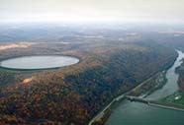
Ratepayer Protections and Cost Controls
April 2022

Slide 47
Competitive pressure drives innovative cost containment proposals
Reduces the cost and reduces the risk to ratepayers

Slide 48
Evolution of U. S. Competitive Transmission
2013
PJM Artificial Island
PJM’s first competitive transmission process
2019
CAISO Round Mountain
CAISO Competitive Solicitation for 500 kV Dynamic Reactive Support
2008
Texas CREZ
Public Utility Commission of Texas Docket 35665
$7 billion of transmission facilities for on‐shore wind
26 proposals from 7 bidders
12 proposals from 6 bidders
$100 million to $1.55 billion
Cost containment provisions included: Overall project caps (various exclusions) Cap on O&M/A&G
Cap on rate of return on equity Cap on equity percentage in rates Cap on annual revenue requirement
Financial penalty for delays
14 bidders
Opportunity to submit cost commitment
Standard of “most efficient and cost effective”
Competitive scope completed at cost less than cost cap with no exceptions or out of scope additions
Selected 8 entities for transmission line construction, including 3 new entrants
Differences in cost containment considered
No cost containment
Reduces the cost and reduces the risk to ratepayers
2

Slide 49
Cost Containment has Proven Value
Monopoly incumbents oppose transmission competition
  Claim that bidding out engineering and construction provides sufficient cost controls
  Criticize cost caps due to exceptions
  Say that transmission competition has not delivered proven benefits
Transmission competition and cost containment aligns interest of transmission service provider with customers
Projects completed by LS Power Grid in 2020 all completed within capital cost caps as bid without exceptions for competitive scope
Project | Region | Description | Final Cost Competitive Scope | Cost Containment | RTO Planning Estimate at Approval ($Year of Occurrence)
Silver Run | PJM | 6 miles 230 kV including submarine cable | $149.5 million | $166.3 million | N/A. Proposals ranged $100 million to $1.55 billion
DesertLink | CAISO | 60 miles 500 kV | $145.1 million | $145.5 million | $159 million
Republic | MISO | 31 miles 345 kV | $56.8 million | $58.1 million | $74 million
Central East Energy Connect | NYISO | 125 miles 345 kV | To be determined | $615 million | $819 million
Reduces the cost and reduces the risk to ratepayers
3

Slide 50
Equity Caps Provide Significant Value
Cap on rate of return on equity
Cap on percentage of equity in capital structure
 | Competitive Proposal | PJM Regulated Utility 1 | PJM Regulated Utility 2 | PJM Regulated Utility 3*
Rate of Return on Equity | 9.0% | 10.5% | 10.8% | 11.4%
Cost of Debt | 3.50% | 4.40% | 4.80% | 3.95%
Equity/Debt Percentages | 40.0% / 60.0% | 50% / 50.0% | 51% / 49.0% | 54.6% / 45.4%
Federal/State Income Tax Rates | 21.0% / 9.0% | 21.0% / 9.0% | 21.0% / 9.0% | 21.0% / 9.0%
Total Pre‐Tax Cost of Capital | 7.1% | 9.0% +28% higher | 9.5% +35% higher | 9.9% +40% higher
Annual Capital Recovery for $3 Billion Rate Base | $212 million | $271 million +$59 million | $285 million +$74 million | $297 million +$85 million
Incremental Cost Over 20 Years |  | +$1.2 billion | +1.5 billion | +1.7 billion
Utility capital structures from https://www.pjm.com/markets‐and‐operations/billing‐settlements‐and‐credit/formula‐rates
*Utility 3 includes 100 bps incentive adder
Reduces the cost and reduces the risk to ratepayers
4

Slide 51
LS Power Grid’s Proposal is Most Affordable
Backed by Strong Cost Containment

Slide 52
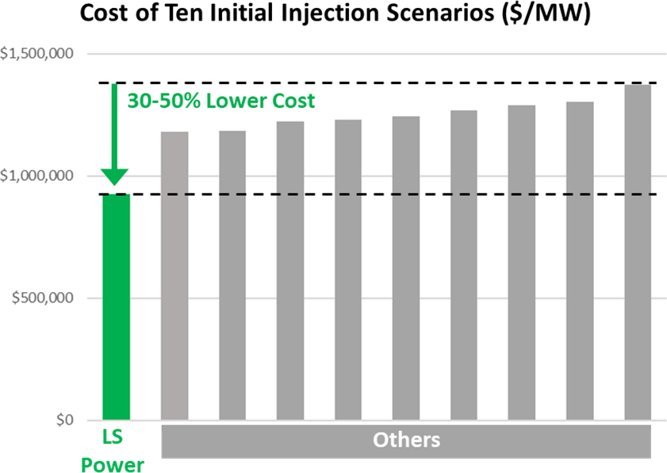


State Agreement Approach Will Identify Least Cost, Least Risk Path
Benefits to New Jersey of LS Power’s Alternating Current (AC) Approach
  Increased system reliability and resilience
  Flexible and expandable
  Avoids significant DC terminal losses
  Avoids expensive unnecessary DC terminals
    As a result, least expensive per unit of capacity integration
    More than 30% less, over $1 billion savings
Minimize impacts through a coordinated plan
  Consolidate onshore corridors, shore landing, and offshore cables
  Smaller footprint
Economic development benefits
  Construction employment
  Union labor
  Sales tax revenue and property tax payments
Community investment commitment
LS Power Grid’s Proposal is Most Affordable

Slide 53

LS Power Ratepayer Protections and Cost Controls
Not all cost containment is created equal
BPU, PJM and their consultants will carefully analyze proposals
  Provisions related to escalation, contingencies, interest rates
  Exceptions and carve outs to cost caps
  Exposure to risk premiums for fixed amounts or ROE adders
LS Power Proposals Include
  Binding Project Cost Cap inclusive of inflation, interest with limited exceptions
  Rate of Return on Equity Cap for the life of the project
  Equity Percentage Cap for the life of the project
  Transmission Revenue Requirement Cap for the first 10 full calendar years of operation
Effects of Capital Savings (30%‐50%) and Annual Savings (30%‐40%) Compound
All caps are one‐sided in favor of ratepayers, without any risk premium
Guaranteed completion date aligns interests of transmission developer with generators
LS Power has delivered on every competitive transmission project it has been awarded
LS Power Grid’s Proposal is Backed by Strong Cost Containment

Slide 54









Comparison of Cost Containment Proposals
 | Capital Cost Cap | Rate of Return on Equity Cap | Equity Percentage Cap | Annual Revenue Requirement Limit
LS Power Grid
Company A
Company B
Company C
Company D
Company E
Company F
Company G
Cost Containment With Limited Exceptions, No Risk Premium Cost Containment With Exceptions
Cost Containment With Risk Premium No Cost Containment
LS Power Grid’s Proposal is Backed by Strong Cost Containment

Slide 55
Conclusion
Analysis will identify the lowest cost and lowest risk approach
  Most affordable plan that minimizes impacts
  Including consideration of cost containment
Competitive pressure drives innovative cost containment proposals
  Capital cost caps provide significant value
  Limits on other rate determinants provide significant value
  Annual revenue requirement cap addresses all elements of rates
LS Power Grid’s proposal is distinguished
  Most affordable
  Backed by the strong cost containment
  Backed by LS Power Grid’s track record

Slide 56
NJ SAA Public Stakeholder Meeting Ratepayer Protections and Cost Controls April 12, 2022
Lathrop Craig
President, PSEG Renewable Transmission

Slide 57


Cost containment protects customers interests, but can also harm them if not evaluated carefully
Cost containment provisions protect customers from unexpected cost increases and provide certainty
However, cost containment can also…
Incentivize proposers to reduce scope and/or quality
Include countless exceptions and adjustments, weakening the commitment and ultimately increasing cost
Lack consequences and penalties for cost or schedule overruns
Savings
Quality
Deliver on time
Stop cost overruns
Previously awarded competitive transmission projects have not delivered benefits as promised
Examples…
Recently, a competitive transmission developer in NY included in its formula rate, for recovery from customers, a cost representing a 40% price increase over its “capped” amount due to scope omitted from its bid
Performance
Multiple competitive transmission circuits have experienced prolonged outages or de-rates shortly after commissioning due to poor quality, lack of spare parts, and other issues
Cost
CWL’s cost containment provisions have no hidden costs and contains minimal adjustments with a guaranteed in-service date

Slide 58









NJ customer protections embedded in Coastal Wind Link
Four important components will secure the best value
for NJ customers
1
Future-proof design: A future proof design to avoid
costly rework and allow system expansion
2
Transmission & generation experience: Brings the knowledge and experience to design, build, and maintain a reliable transmission system
3
Competition: Promotes competition among OSW leaseholders by supporting multiple lease areas; independent of NJBPU’s remaining generation solicitations
4
Cost & Schedule Certainty: Strong cost caps with
minimal exceptions and a guaranteed delivery date

Slide 59

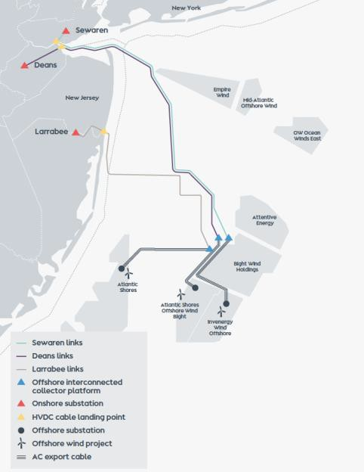

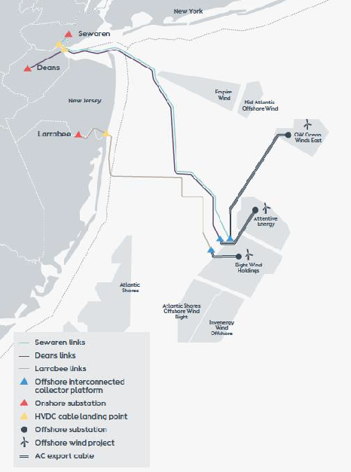
Coastal Wind Link meshed grid design enables faster, lower risk offshore wind generation at the lowest expected OREC prices
CWL offers a unique meshed grid solution which provides reliability and flexibility
275kV connection to offshore wind farms is designed to accommodate future, larger, and more efficient wind turbines
Unique design allows continuous power flow across offshore platforms
Interconnects different areas in NJ using the meshed grid to increase reliability
Increases the annual energy production for offshore wind generation by reducing curtailment
CWL’s meshed grid design will decrease OREC prices, directly benefiting New Jersey customers

Slide 60


Coastal Wind Link guarantees the best value for NJ customers
Long-term commitment in
New Jersey
Clear and firm cost
commitments
PSEG and Ørsted are long-term partners in the state of New Jersey and have more experience than anyone else
CWL will protect New Jersey customers with no hidden costs and clear commitment on schedule
Most efficient design
CWL future-proof meshed grid design will reduce the costs of offshore wind while increasing system reliability

Slide 61
Thank you!

Slide 62



New Jersey Board of Public Utilities
Ratepayer Protections under the State Agreement Approach
Scaling Renewable Energy
APRIL 12, 2022

Slide 63


Ratepayer Protections
The cost savings to consumers of the SAA approach are substantial. This presentation reviews some of the key ways that the SAA develops offshore wind in the most cost-effective manner, providing low cost and clean renewable energy while protecting consumers from unanticipated costs
Avoided Costs
Right Sizing
Permitting / Advanced Permitting
Rate Protections

Slide 64


Avoided Costs
Planned transmission creates ratepayer protections in different ways:
Reduces the number of cables and platforms that must be procured, sited, installed, and maintained
  Competition for transmission is only part of the story. Substantial savings come from designs that leverage the efficiencies of moving away from offshore radial designs
Maximizes points of interconnection and avoids certain costly onshore grid upgrades
An OceanGridTM has been shown to materially reduce curtailments of wind energy in multiple studies, which showed significant annual consumer savings.¹ These savings in New England, for example, were found to be in excess of over $300 million per year
SAA transmission can also be used for already awarded offshore wind, potentially eliminating another multi-hundred million transmission connection
¹ https://www.brattle.com/wp-content/uploads/2021/05/18939_offshore_transmission_in_new_england_- the_benefits_of_a_better-planned_grid_brattle.pdf at page 19.

Slide 65
Avoided Costs Continued
Planned Transmission Enables the Scaling of Wind Energy, Reducing the Cost of Electricity and Resulting in Significant Public Health Benefits
A 2020 ISO New England study found that 8 GWs of wind lowered RTO-wide production cost for electricity by one-half, and reduced carbon emissions by one-third²
The EPA has noted that “[h]ealth research has established relationships between air pollution, air quality, and health effects that range from respiratory symptoms and missing a day of school or work, to severe effects such as hospital admissions, heart attacks, onset of chronic heart and lung diseases, and premature death.” An analysis of the first 2,400 MW of wind for New York found it resulted in in 8 to 18 fewer annual premature deaths and avoided multiple, costly adverse health outcomes.³ Other studies have found that thousands of premature deaths are avoided and billions in costs saved with large-scale adoption of renewable energy in the United States.⁴
https://www.iso-ne.com/static-assets/documents/2020/10/2019-anbaric-economic-study-final.docx
https://tethys.pnnl.gov/publications/draft-generic-environmental-impact-statement-procurement-offshore-wind
https://www.nature.com/articles/nenergy2017134 noting 3,000 to 12,700 avoided premature deaths and $29.7 to $112.8 billion in
avoided costs from renewable energy installed between 2007 and 2015

Slide 66
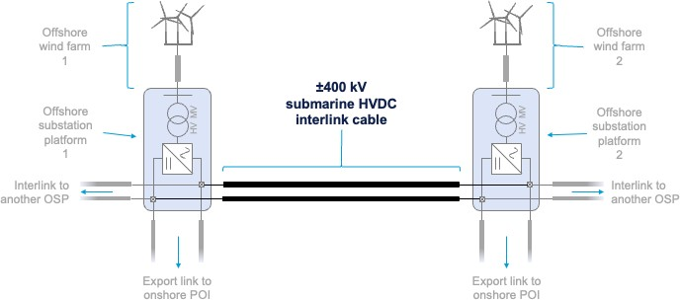
Right Sizing
Planned Transmission through the State Agreement Approach enables consumer savings by ensuring that:
Suboptimal designs that lock in costly outcomes such as a lack of expandability are avoided,
While also ensuring that:
Designs are right sized for desired day one operational characteristics
An example of this are Anbaric’s HVDC breaker-ready “plug and play” platforms that can be utilized in a reduced cost but capable networked configuration that still allow for very low loss, expandible HVDC technology now and full HVDC breakers to be swapped in at a future time.

Slide 67
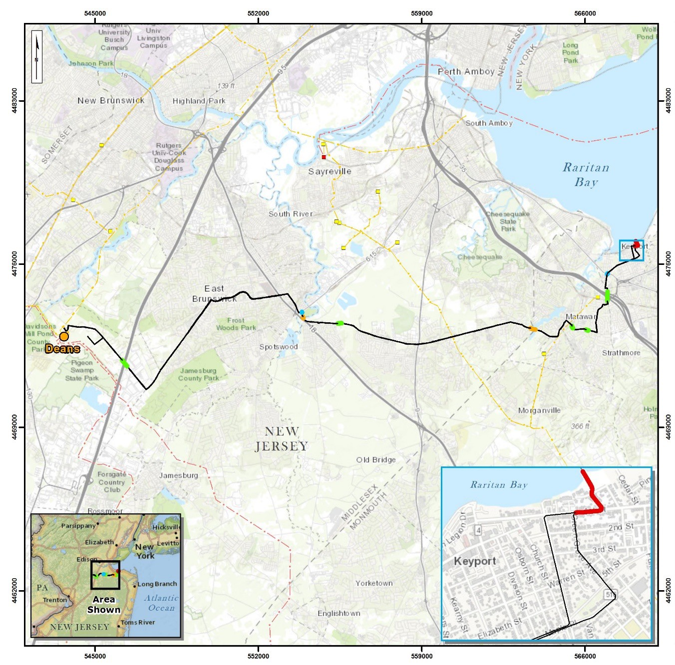
Competitive planned transmission can also protect consumers through developer work to de-risk projects.
An example of this is seen here, where Anbaric has fully permitted the overland, completely underground route from the deep drilling under the beach to the Deans substation

Slide 68
Rate Design Protections
A key set of consumer protections from the competitive State Agreement Approach transmission process are found in rate terms
Traditional utility rates can have 11%, or higher, returns on equity (“ROE”)
SAA allows for competition so that ROEs are voluntarily reduced. Here is an example of a traditional utility transmission rate compared to a lower, competitive ROE:
110
100
90
80
70
60
50
Lower ROEs Reduce Costs to Consumers
Annual Total Revenue Requirement ($ millions/yr) (normalized to first year TRR of $100 million)
Traditional Utility @ 11% ROE & 50% Equity Revenue Requirment @ 8.5% ROE & 50% Equity
Yr 1
Yr 2
Yr 3
Yr 4
Yr 5
Yr 6
Yr 7
Yr 8
Yr 9
Yr 10
Yr 11
Yr 12
Yr 13
Yr 14
Yr 15
Yr 16
Yr 17
Yr 18
Yr 19
Yr 20
Yr 21
Yr 22
Yr 23
Yr 24
Yr 25
Yr 26
Yr 27
Yr 28
Yr 29
Yr 30
Yr 31
Yr 32
Yr 33
Yr 34
Yr 35
Yr 36
Yr 37
Yr 38
Yr 39
Yr 40

Slide 69
Rate Design Protections Continued, Equity Structure
In addition to ROE, equity can voluntarily be capped. This is important because a lower ROE with a higher equity structure can produce the same result as a higher ROE with a lower equity structure.
Consumers Are Not Helped if Lower ROEs
are Combined with a Higher Proportion of Equity Funding
110
Annual Total Revenue Requirement ($ millions/yr)
(normalized to first year TRR of $100 million)
Traditional Utility @ 11% ROE & 50% Equity
Total Revenue Requirement @ 8.5% ROE & 75% Equity
100
90
80
70
60
50
Yr 1
Yr 2
Yr 3
Yr 4
Yr 5
Yr 6
Yr 7
Yr 8
Yr 9
Yr 10
Yr 11
Yr 12
Yr 13
Yr 14
Yr 15
Yr 16
Yr 17
Yr 18
Yr 19
Yr 20
Yr 21
Yr 22
Yr 23
Yr 24
Yr 25
Yr 26
Yr 27
Yr 28
Yr 29
Yr 30
Yr 31
Yr 32
Yr 33
Yr 34
Yr 35
Yr 36
Yr 37
Yr 38
Yr 39
Yr 40

Slide 70
Rate Design Protections Continued, Equity Structure
A win for consumers is being able to see a low ROE with a low equity structure.
110
Consumers Win with Lower ROEs Combined with a Lower Proportion of Equity Funding
Annual Total Revenue Requirement ($ millions/yr)
(normalized to first year TRR of $100 million)
100
Traditional Utility @ 11% ROE & 50% Equity
Revenue Requirment @ 8.5% ROE & 50% Equity
90
80
70
60
50
Yr 1
Yr 2
Yr 3
Yr 4
Yr 5
Yr 6
Yr 7
Yr 8
Yr 9
Yr 10
Yr 11
Yr 12
Yr 13
Yr 14
Yr 15
Yr 16
Yr 17
Yr 18
Yr 19
Yr 20
Yr 21
Yr 22
Yr 23
Yr 24
Yr 25
Yr 26
Yr 27
Yr 28
Yr 29
Yr 30
Yr 31
Yr 32
Yr 33
Yr 34
Yr 35
Yr 36
Yr 37
Yr 38
Yr 39
Yr 40

Slide 71
Rate Design Protections Continued, Caps and Incentives
Competitive transmission allows for still more consumer protections.
These can shield
consumers in the event of cost overruns and time delays, and can be structured in a variety of ways.
One way to incentivize on-time and on-budget performance is to have a ROE that declines in the event of cost overruns or schedule delays. Similarly, the rate structure can be structured to have an better return if actual costs come in under bid, creating an incentive to do better than what was submitted with a bid.
Overall cost caps can shield consumers from having to pay for any cost overruns past a certain point. Contrast that with traditional utility transmission rates which recover any overruns.

Slide 72

Cost Containment Provisions
An example of these design elements working together can be seen in Anbaric’s comprehensive proposal:
Low ROE of 8.5%
Not a base ROE, this is the full ROE
ROE is for project life; FERC
rate adjustments are
waived
No Incentive Adders to ROE
e.g. no 50 BP adder for RTO
membership
Declining ROE if actual costs exceed bid estimates
Declining ROE
for Schedule Delays
Pass through of liquidated damages
for delay
Equity Capped at 45%
ROE applies to max of 45%
Overall Cap on Construction Costs ROE declines to 5.75% if costs rise above bids, but no recovery of costs (not just a 0% ROE) is allowed above cap. Cap is indexed bid multiplied by 1.25
ROE can only increase if actual costs ARE LESS
than bid

Slide 73

THANK YOU.
Scaling Renewable Energy
12

Slide 74

New Jersey
Division of Rate Counsel Comments
Brian O. Lipman, Esq. // Director

Slide 75
New Jersey Division of Rate Counsel // Comments
INTRODUCTION
Investments being explored by the Board through the SAA have the ability to reduce future costs for ratepayers
Board’s focus should remain on this important goal

Slide 76
New Jersey Division of Rate Counsel // Comments
Rate Counsel encourages Board Staff to be deliberate in the OSW transmission selection process.
Whether a cost-effective OSW transmission opportunity exists, with a reasonable risk profile, that will lower the cost of New Jersey’s clean energy commitments.
Promoting cost-effective OSW transmission options for New Jersey OSW projects and New Jersey ratepayers
“None of the Above” is an option

Slide 77
New Jersey Division of Rate Counsel // Comments
Rate Counsel encourages Board Staff to recommend the most cost-effective OSW transmission solution.
least-cost option
reduces overall future OSW costs and minimizes unnecessary risk exposure for ratepayers
select an option that is, in total, reasonable, balancing cost and risk considerations
higher cost projects will expose NJ ratepayers to higher financial risks

Slide 78
New Jersey Division of Rate Counsel // Comments
Rate Counsel wants to assure that selected OSW transmission projects minimize ratepayer risks.
Developers know more about operating in an offshore environment and should assume the risk
consider proposals that offer to insulate ratepayers from these risks

Slide 79
New Jersey Division of Rate Counsel // Comments
Rate Counsel requests that any final Board Staff recommendation clearly identify and enumerate ratepayer impacts, not just OSW benefits.
specific ratepayer impacts and benefits that include cost and risk considerations
ratepayer costs compared to ratepayer benefits

Slide 80
New Jersey Division of Rate Counsel // Comments
CONCLUSIONS

Slide 81
New Jersey Offshore Wind Transmission State Agreement Approach
Ratepayer Protections and Cost Controls
Break 11:40 – 11:55 pm
In the Matter of Declaring Transmission To Support Offshore Wind a Public Policy of the State of New Jersey
Docket number QO20100630

Slide 82
New Jersey Offshore Wind Transmission State Agreement Approach
Ratepayer Protections and Cost Controls
Public Comment Period
Once we’ve called on all pre-registered speakers, anyone who would like to make comments that did not pre-register to speak will be able ‘raise their hand’ through Zoom and we will call on you. If you’re joining this meeting by phone, you can raise your hand by pressing *9 and you can unmute yourself by pressing *6.
In the Matter of Declaring Transmission To Support Offshore Wind a Public Policy of the State of New Jersey
Docket number QO20100630

